Slide 1
The 6th I AM Statement

Slide 2
John 13
³³ “My children, I will be with you only a little longer. You will look for me, and just as I told the Jews, so I tell you now: Where I am going, you cannot come………
³⁶ Simon Peter asked him, “Lord, where are you going?”
Jesus replied, “Where I am going, you cannot follow now, but you will follow later.”………
John 14
“Do not let your hearts be troubled. You believe in God; believe also in me. ² My Father’s house has many rooms; if that were not so, would I have told you that I am going there to prepare a place for you? ³ And if I go and prepare a place for you, I will come back and take you to be with me that you also may be where I am. ⁴ You know the way to the place where I am going.”

Slide 3
John 13
³³ “My children, I will be with you only a little longer. You will look for me, and just as I told the Jews, so I tell you now: Where I am going, you cannot come………
³⁶ Simon Peter asked him, “Lord, where are you going?”
Jesus replied, “Where I am going, you cannot follow now, but you will follow later.”
John 14
“Do not let your hearts be troubled. You believe in God; believe also in me. ² My Father’s house has many rooms; if that were not so, would I have told you that I am going there to prepare a place for you? ³ And if I go and prepare a place for you, I will come back and take you to be with me that you also may be where I am. ⁴ You know the way to the place where I am going.”
⁵ Thomas said to him, “Lord, we don’t know where you are going, so how can we know the way?”
⁶ Jesus answered, “I am the way and the truth and the life. No one comes to the Father except through me. ⁷ If you really know me, you will know my Father as well. From now on, you do know him and have seen him.”

Slide 4
“Lord, we don’t know where you are going, so how can we know the way?”
“I am the way and the truth and the life. No one comes to the Father except through me.

Slide 6
“Lord, we don’t know where you are going, so how can we know the way?”
“I am the way and the truth and the life. No one comes to the Father except through me.

Slide 7
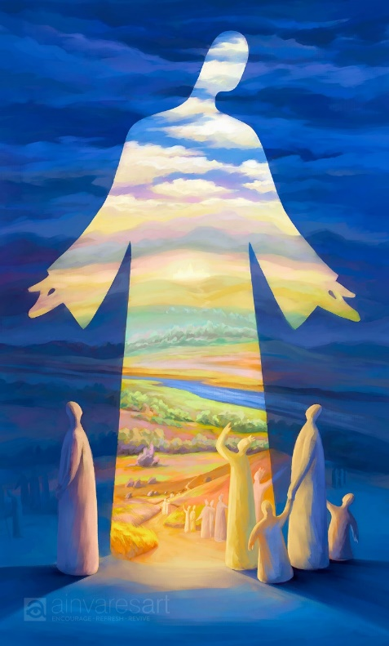

Slide 8
“Lord, we don’t know where you are going, so how can we know the way?”
“I am the way and the truth and the life. No one comes to the Father except through me.

Slide 10
“Lord, we don’t know where you are going, so how can we know the way?”
“I am the way and the truth and the life. No one comes to the Father except through me.

Slide 11
“ For in him we live (life) and move (way) and have our being (true relationship with God the Father)”.

